Slide 1
CIS 508 Machine Learning in Business
Assignment – 4
Ishika Gupta - 1229311176

Slide 2
Problem Statement / Dataset
To predict the final price of a home – Regression problem
Training Data:
1460 rows, 81 columns.
Target column: SalePrice
Testing Data:
1459 rows, 80 columns
Both Datasets have a mixture of numerical and categorical columns

Slide 3
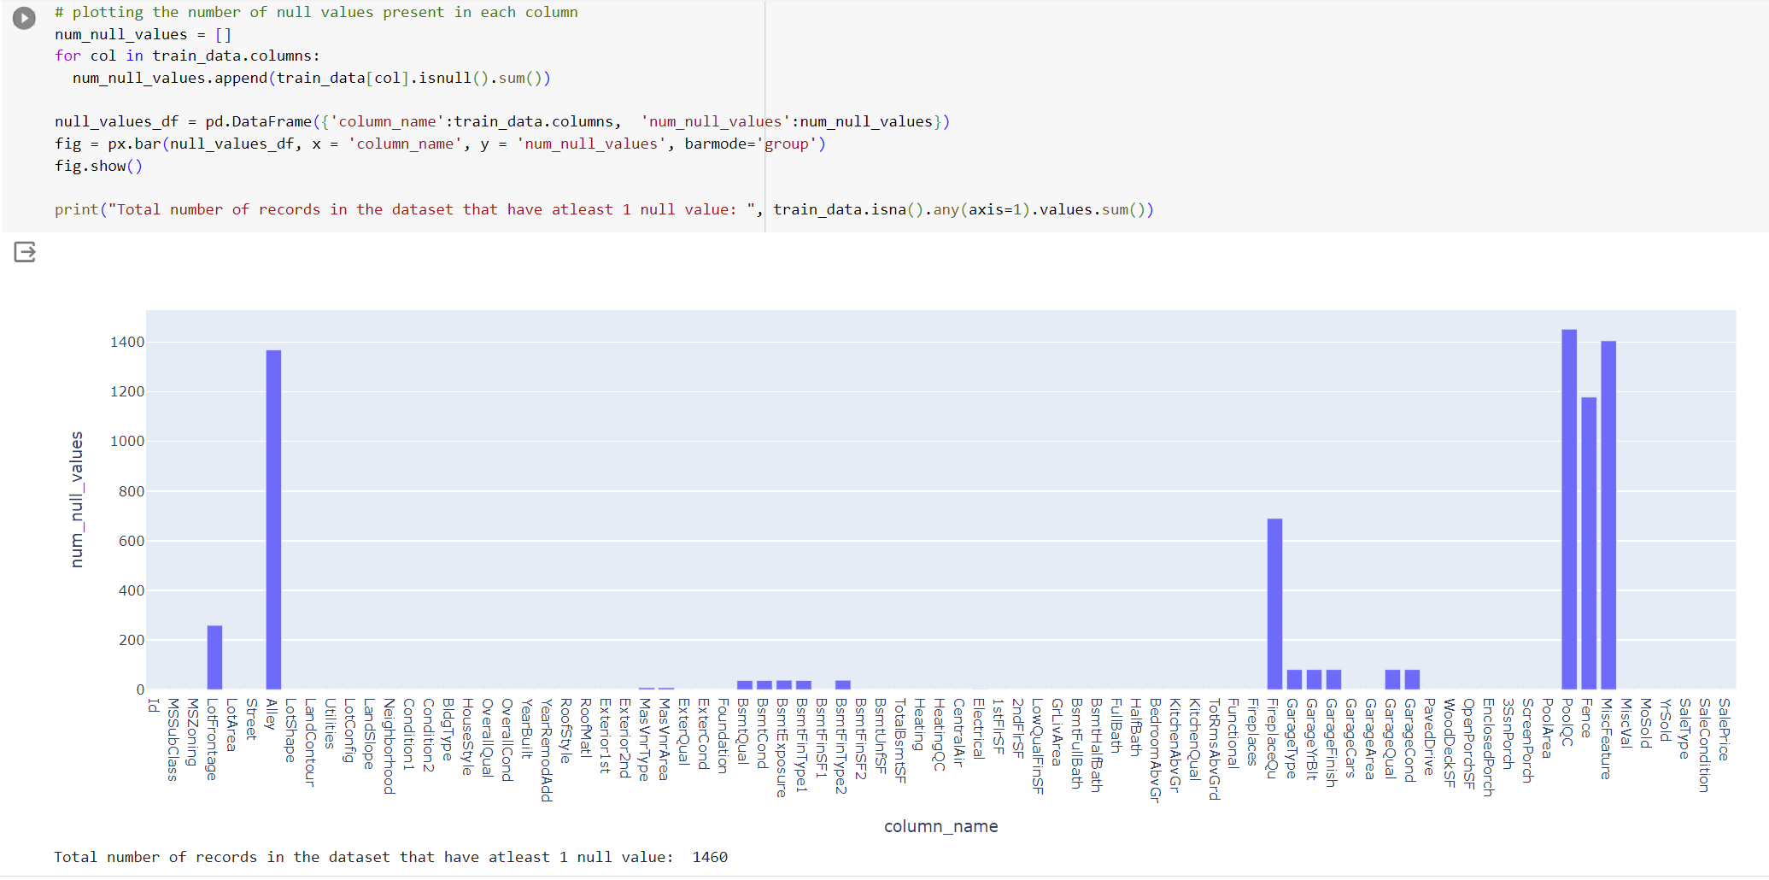
Data preprocessing – Missing values
Columns with missing / null values and their count

Slide 4
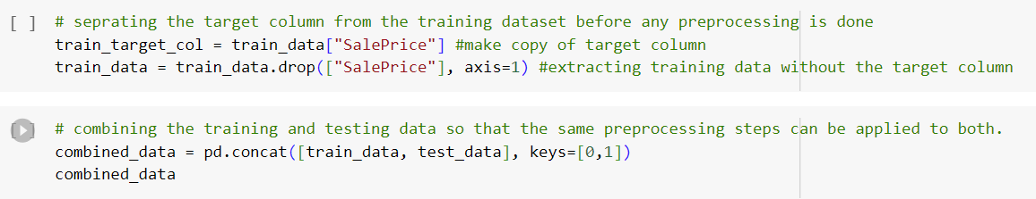
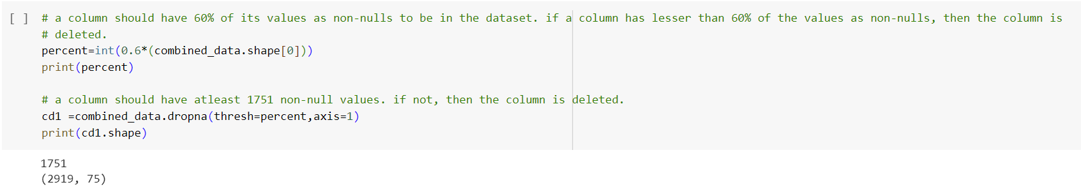
Data Preprocessing – Missing values
Combining the training and testing dataset so that the same columns can be removed from both the datasets
Removing columns that have more than 60% of its values as null values
5 columns were deleted

Slide 5
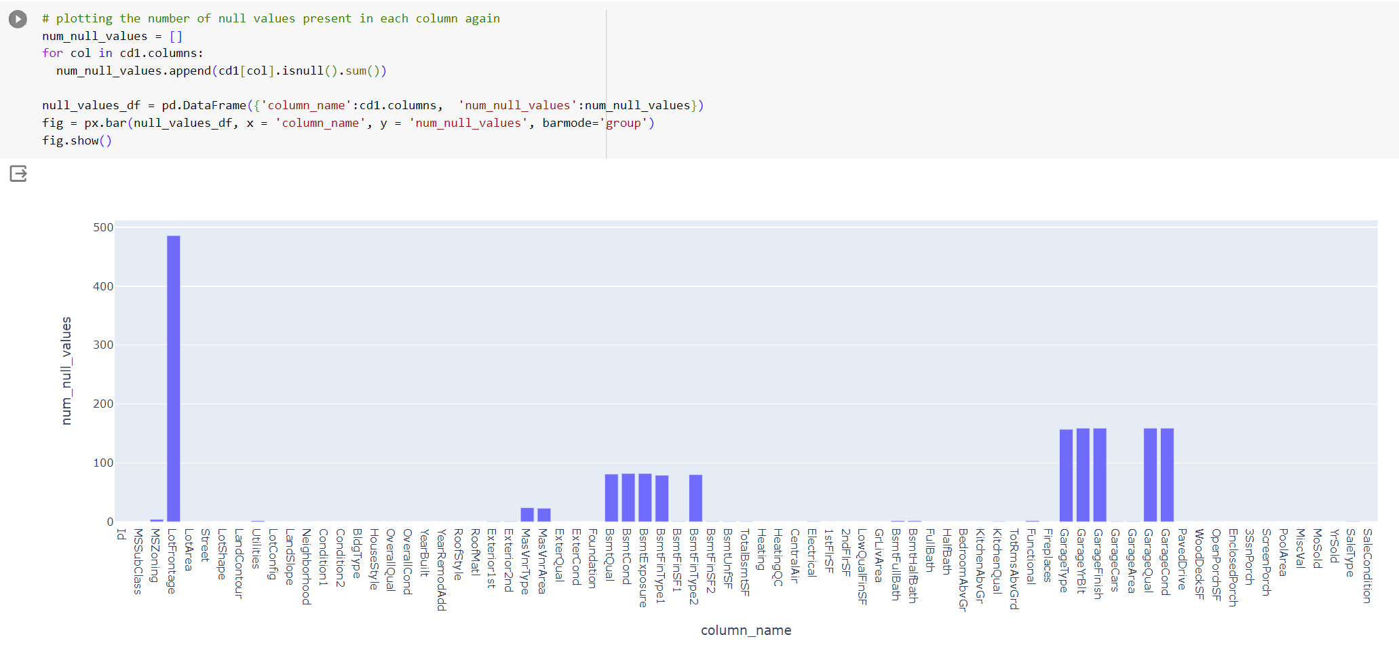
Data Preprocessing – missing values
There are still some columns that have null values

Slide 6
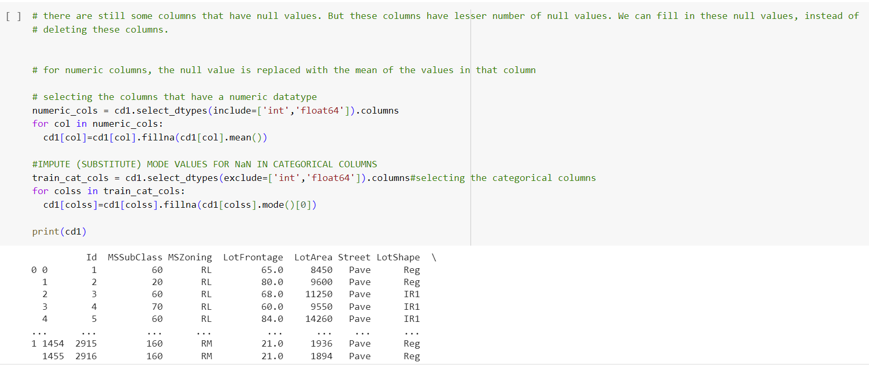
Data Preprocessing – Null values
For numerical columns, replaced null values with the mean of that column
For categorical columns, replaced null values with the most common value in that column
No more null values in the dataset now

Slide 7
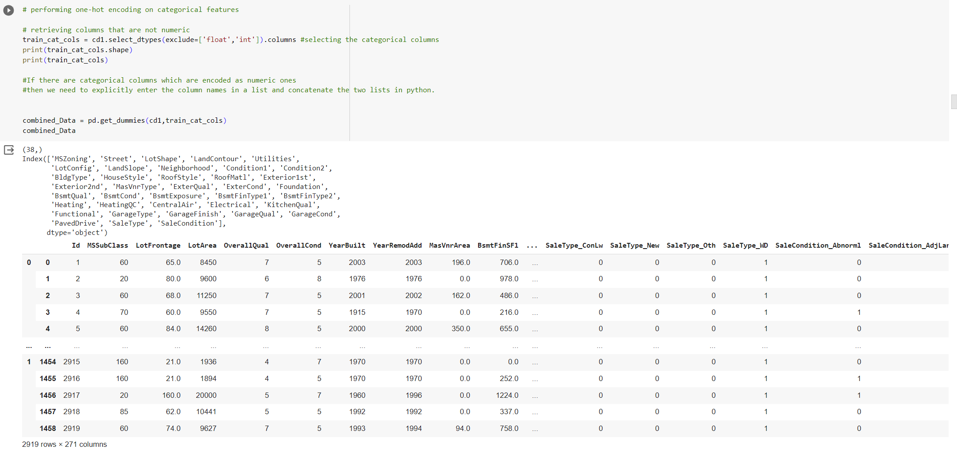
Data Preprocessing – One Hot Encoding
There are 38 categorical columns in the dataset
Number of columns increased from 75 to 271 after one hot encoding the categorical columns

Slide 8
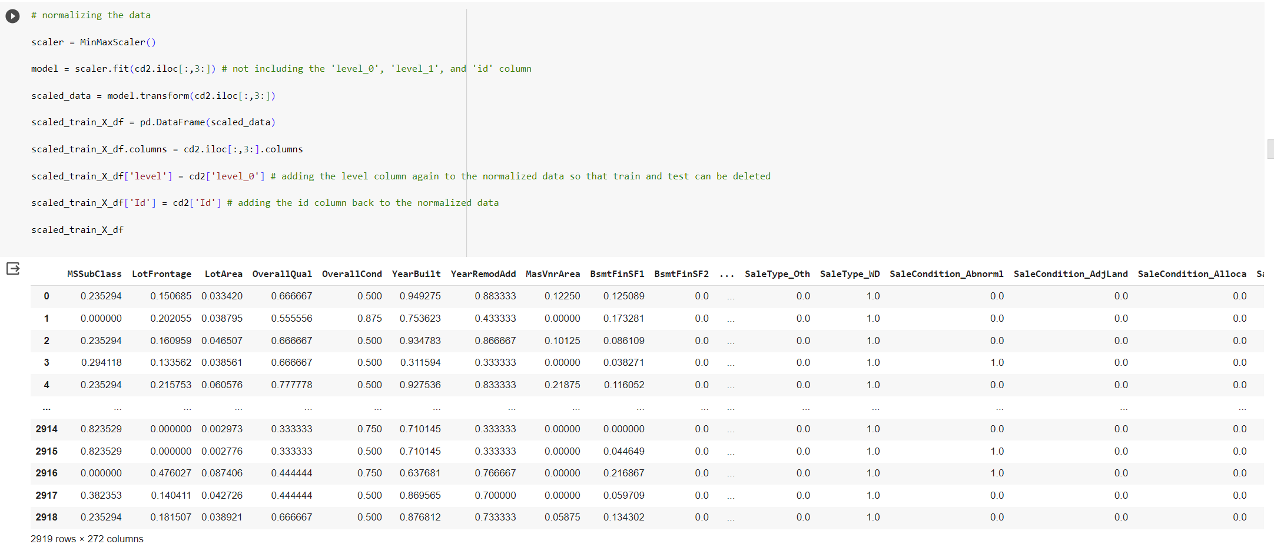
Data Preprocessing – Normalizing the data
Used Min-Max Scaling to bring all values in the range of 0-1
Every column will have an equal impact on the predictions now

Slide 9
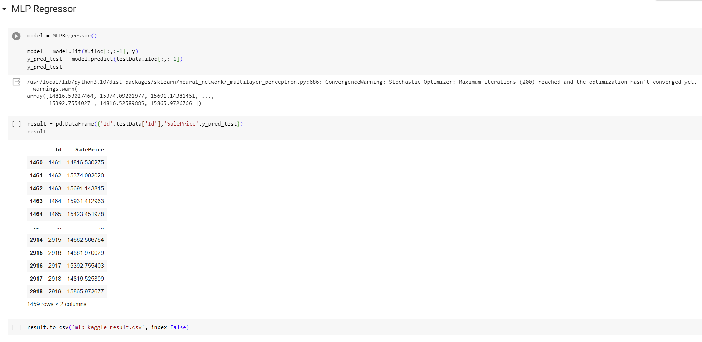
MLP Regressor

Slide 10
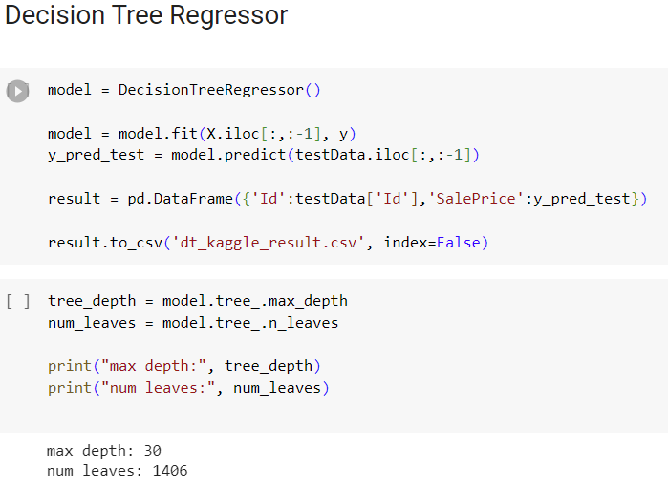
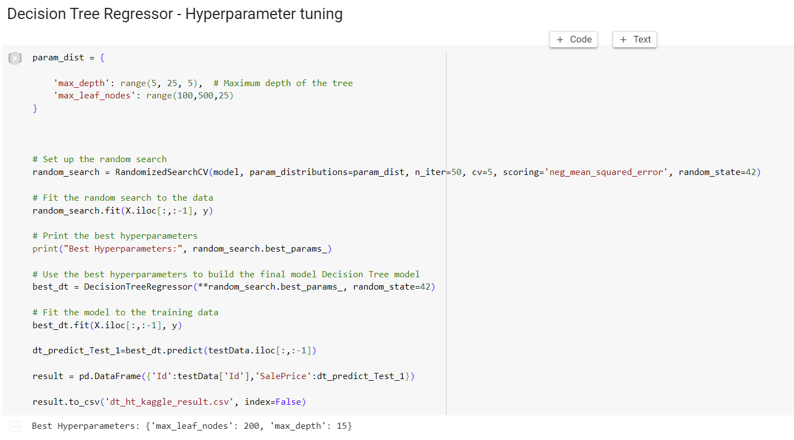
Decision Tree Regressor

Slide 11
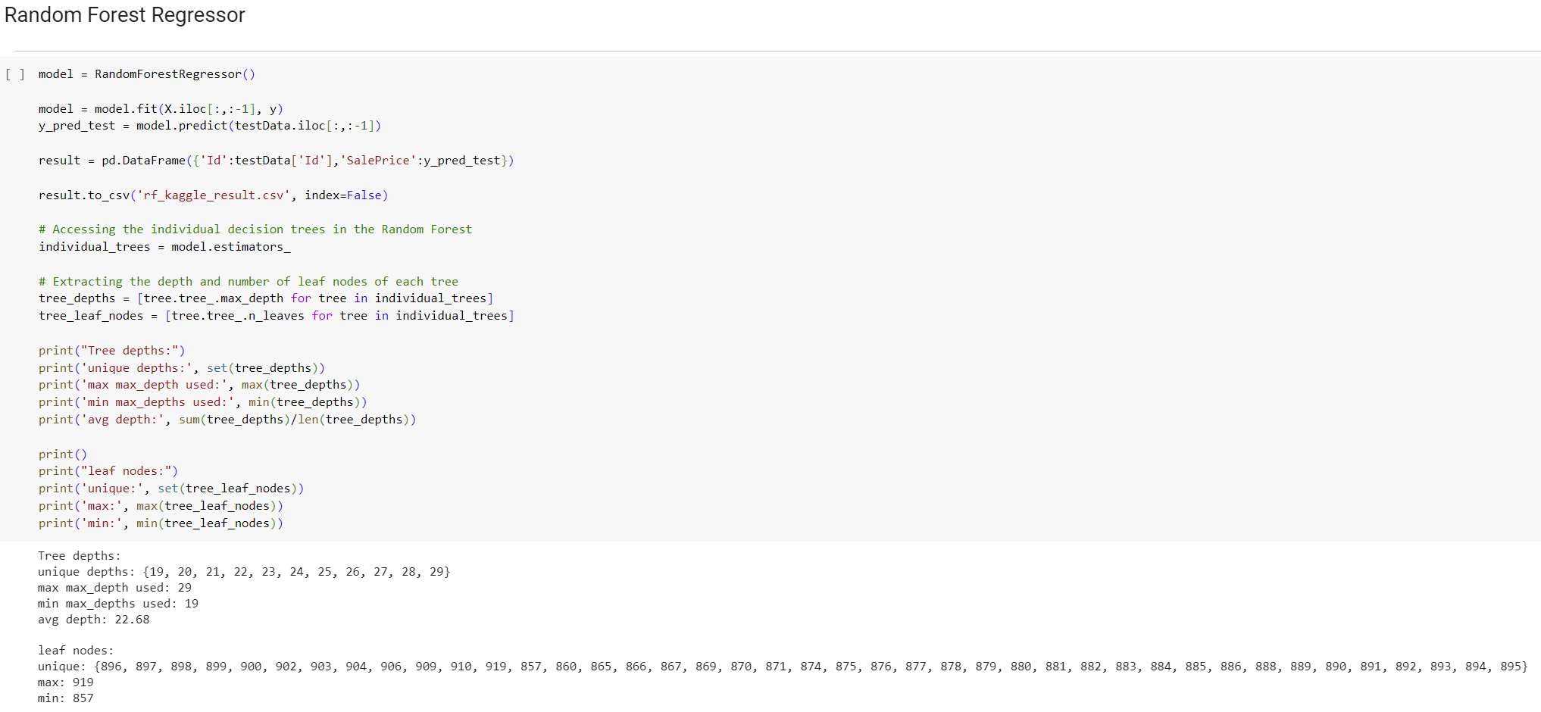
Random Forest Regressor

Slide 12
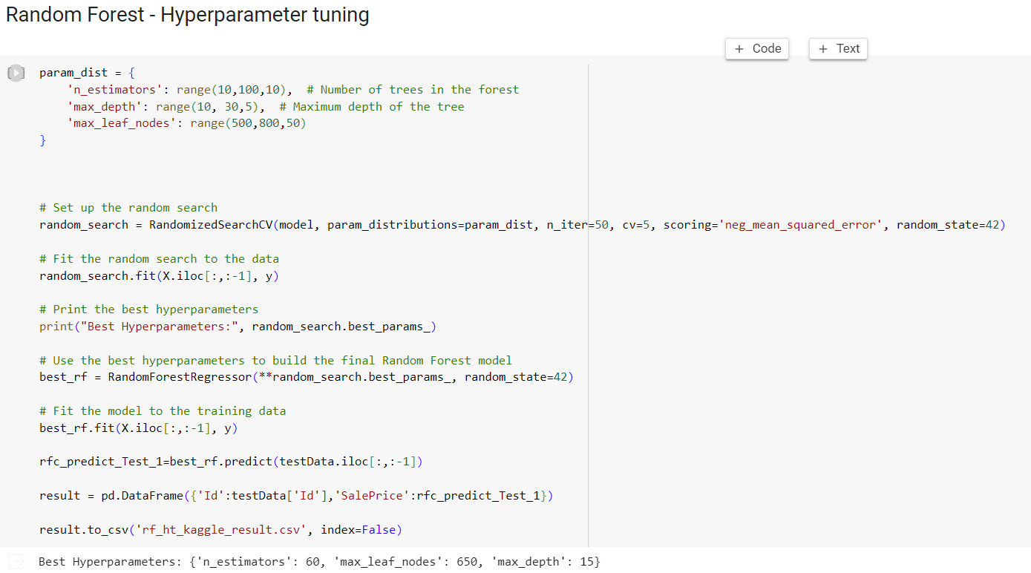
Random Forest Regressor

Slide 13
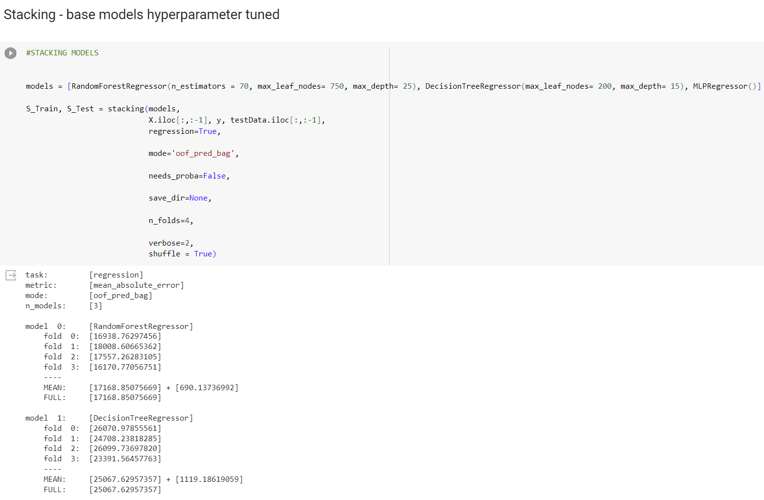
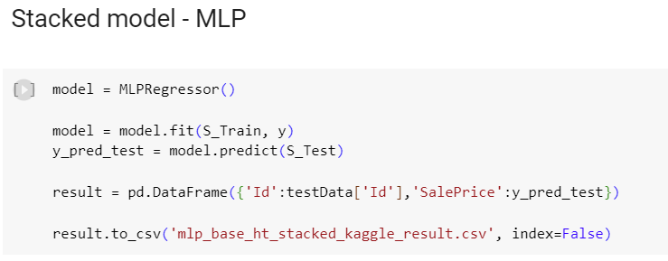
Stacking

Slide 14
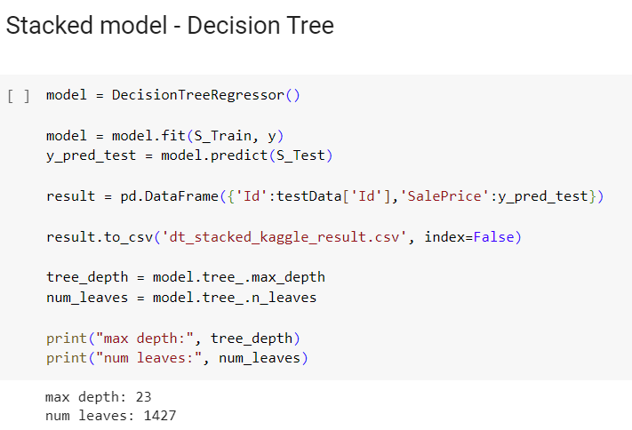
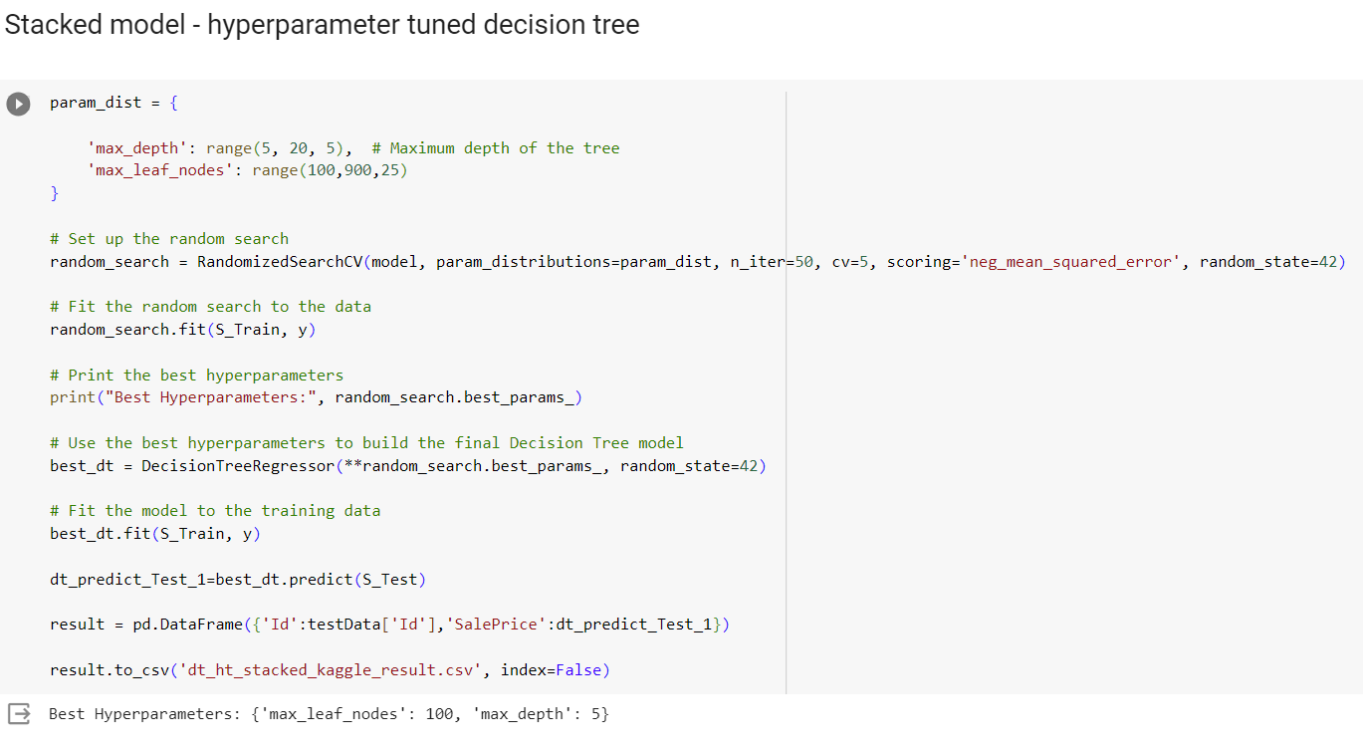
Stacked models

Slide 15
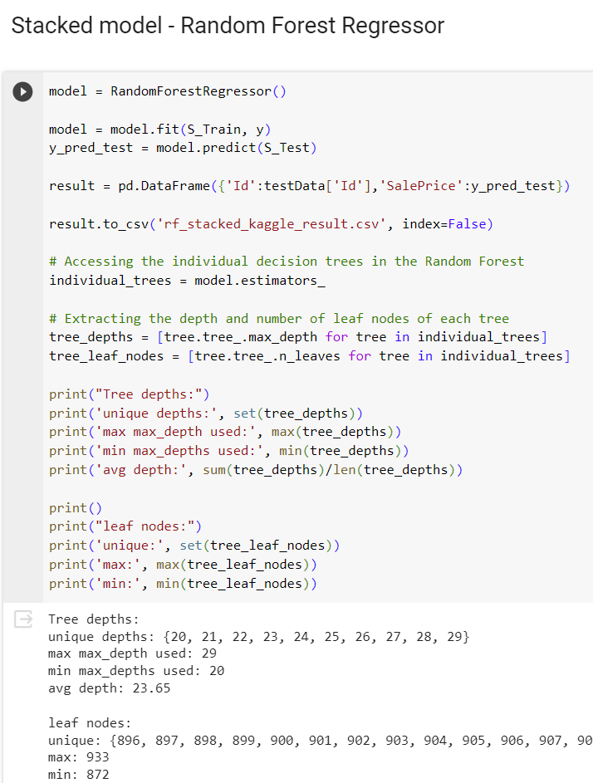
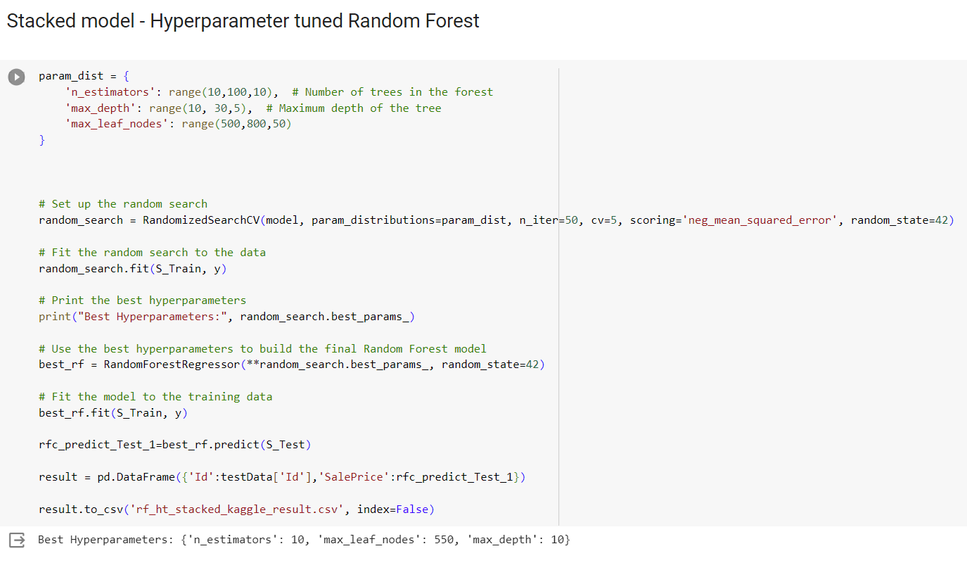
Stacked models

Slide 16
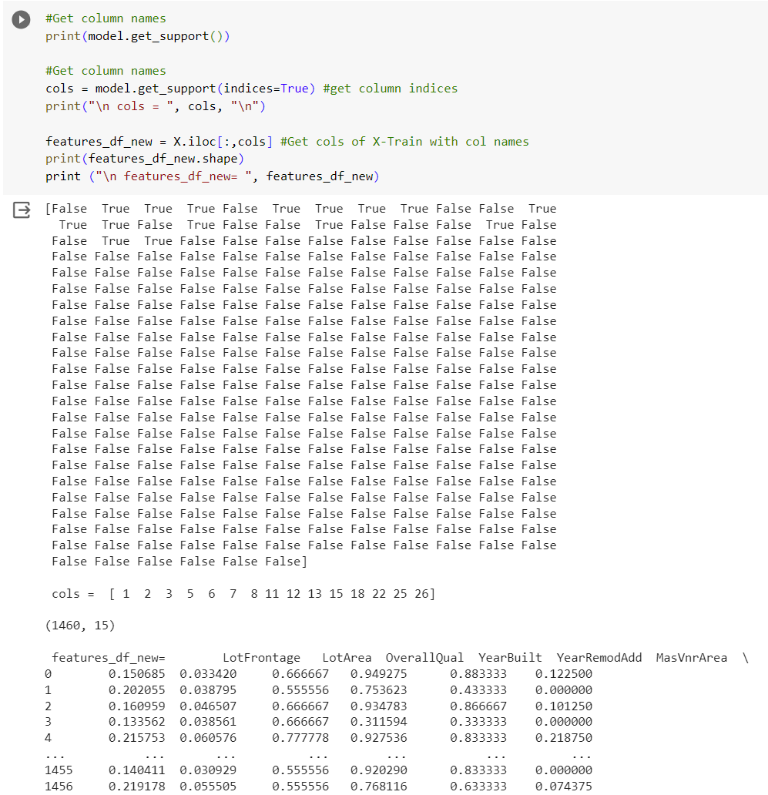
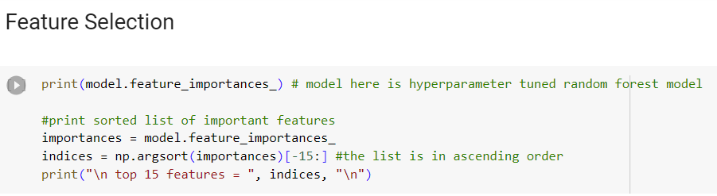
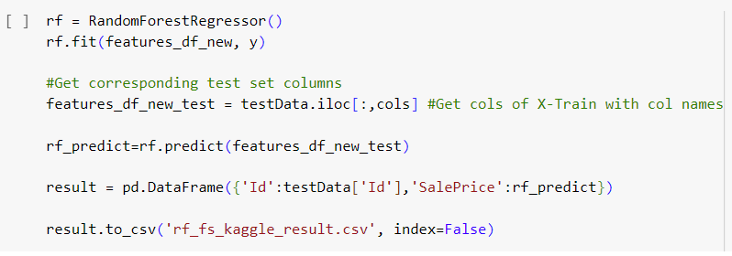
Feature Selection

Slide 17
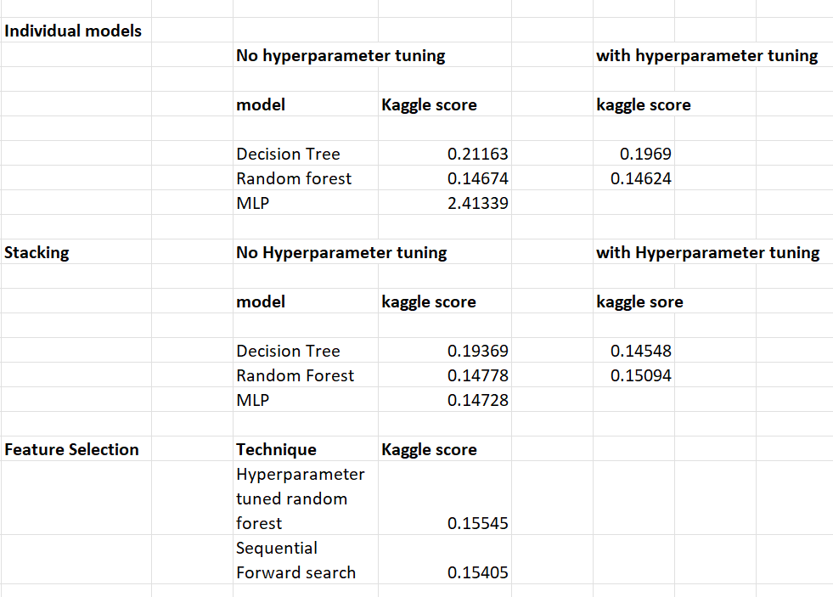
Comparing models
In individual models, a hyperparameter tuned random forest model performed the best.
After stacking, the hyperparameter tuned decision tree stacked model performed the best.
Hyperparameter tuning in most of the cases improved performance.
Performing feature selection with 15 features did not perform better than the individual models without explicit feature selection and stacking
Kaggle Leaderboard highest score: 0.0
My Best Kaggle score: Hyperparameter tuned stacked decision tree model – 0.14548

Slide 18
Conclusion
Stacking provided the best results because the suitable base models were chosen – Decision Trees, Random Forest and MLP work good for large datasets with large number of features
Getting good results with feature selection is hard because it is difficult to determine how many features should be considered. 15 could have been too many features too less features.
Sequential forward search performed better than using a hyperparameter tuned random forest model to know what the best features are.

